Slide 1
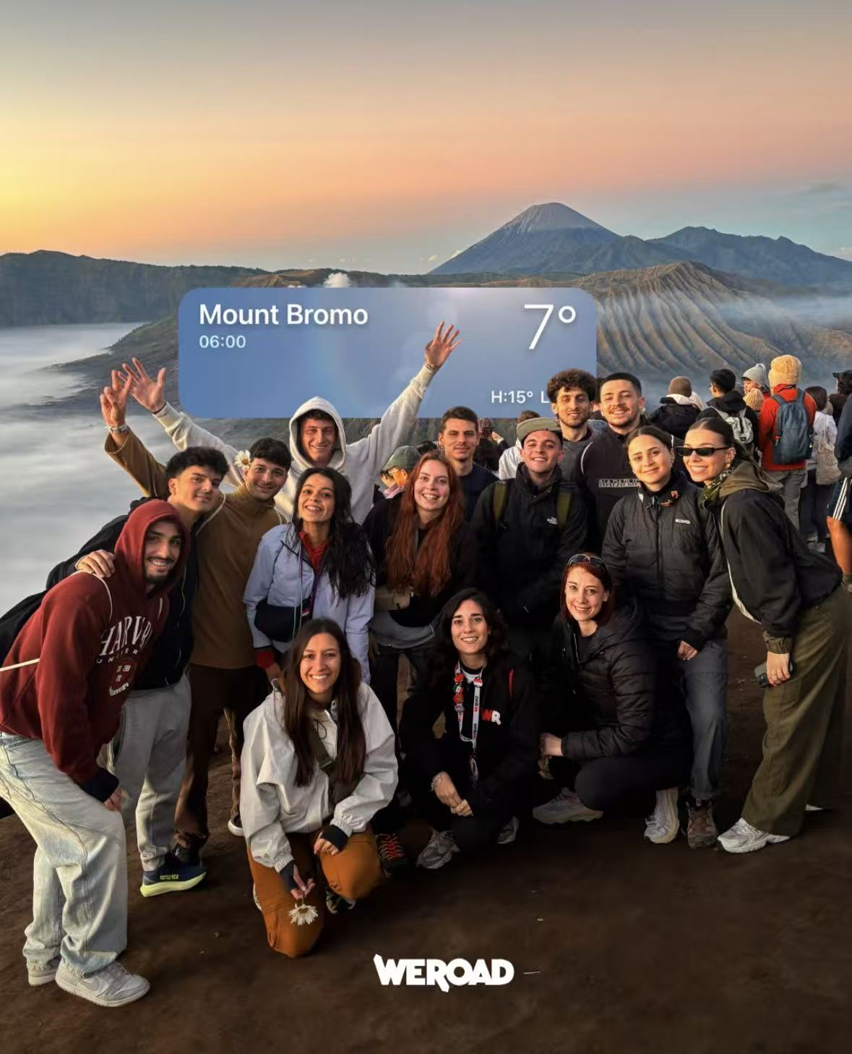

SOCIAL CONTENT
THAT MOVES
PEOPLE TO TRAVEL
Content · creators · community · UGC
ENGLISH EDITION
DU FANG / OVERSEAS MARKETING

Slide 2
ROLE / SCALE
02
THE WORK CONNECTED
FOUR GROWTH LEVERS.
30
60+
4+
270K+
organic posts
& short videos
creator
collaborations
community
events
Instagram
community
PUBLISH → SOURCE → ACTIVATE → REUSE

Slide 3
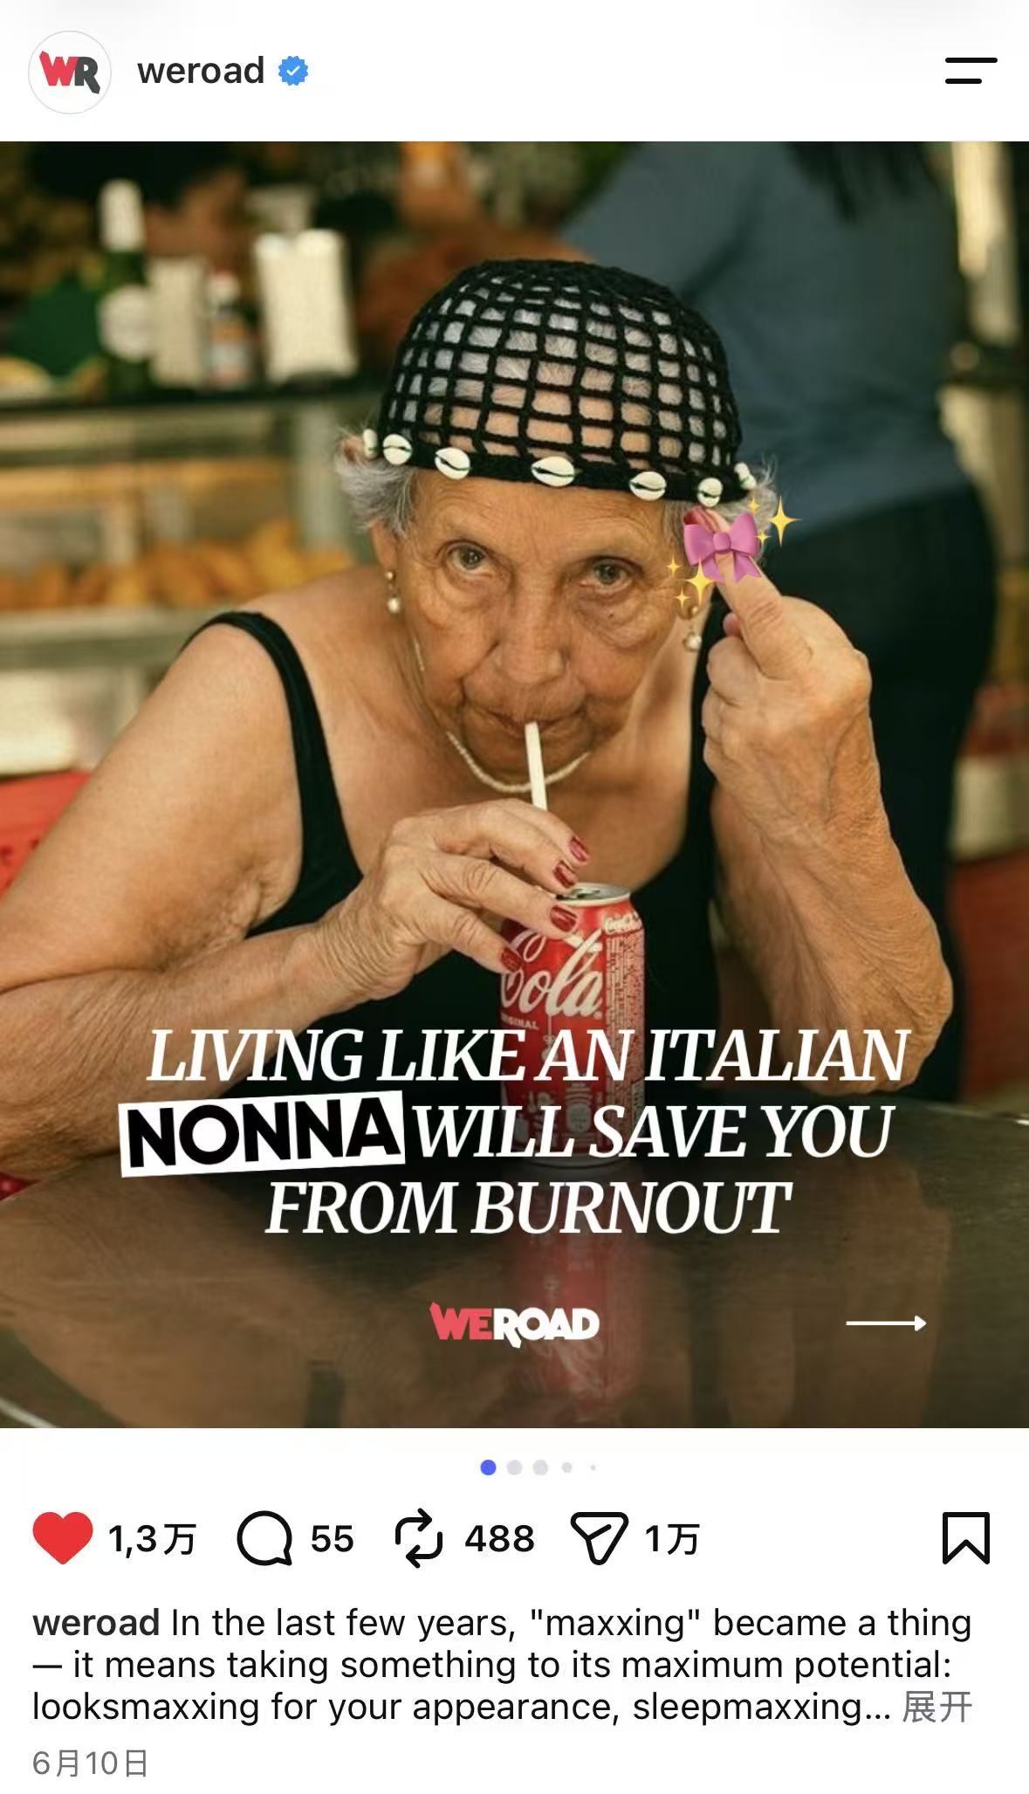
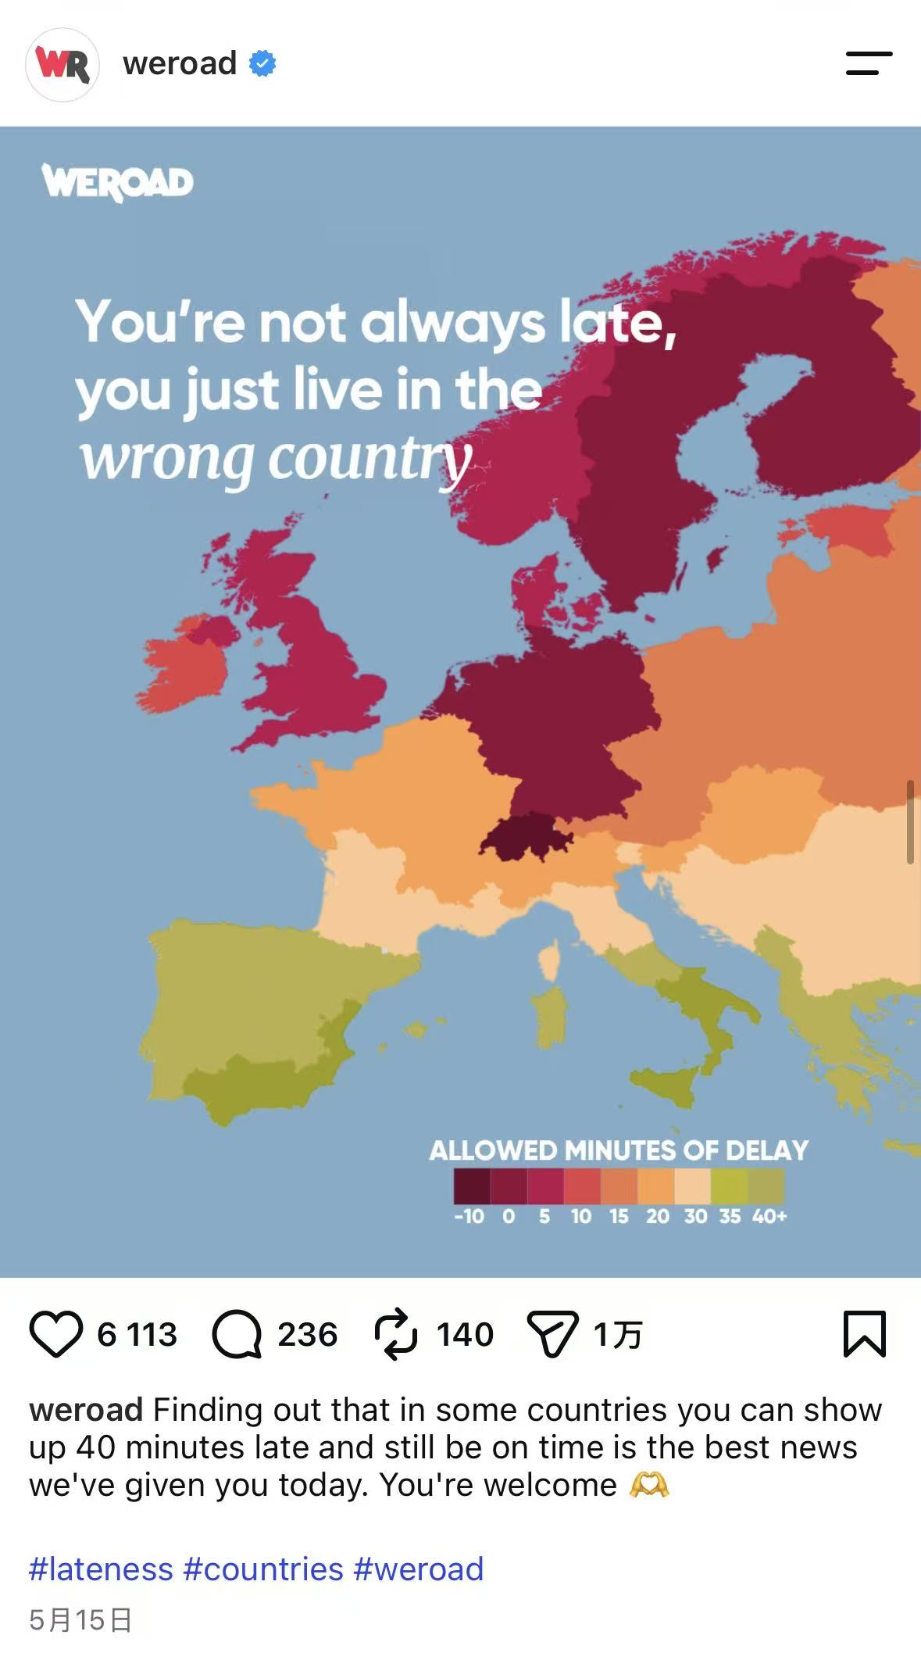
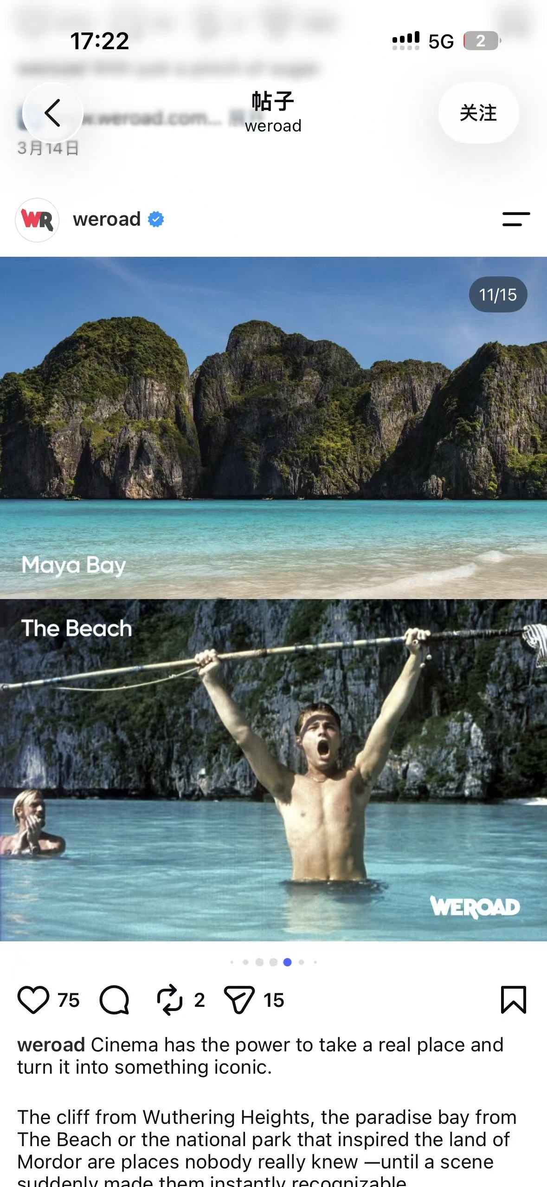
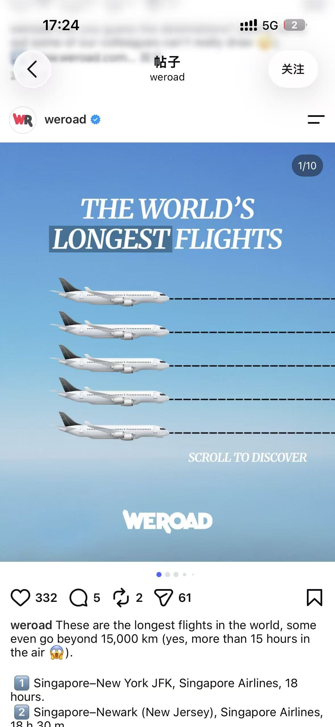
ORGANIC CONTENT
03
TRAVEL FACTS
BECAME SHAREABLE
CULTURE.
Editorial hooks combined cultural insight, destination discovery and visual participation—giving the feed more than one reason to be saved or shared.
30 posts & short videos
Top content: 50K+ views / 200+ interactions

Slide 4
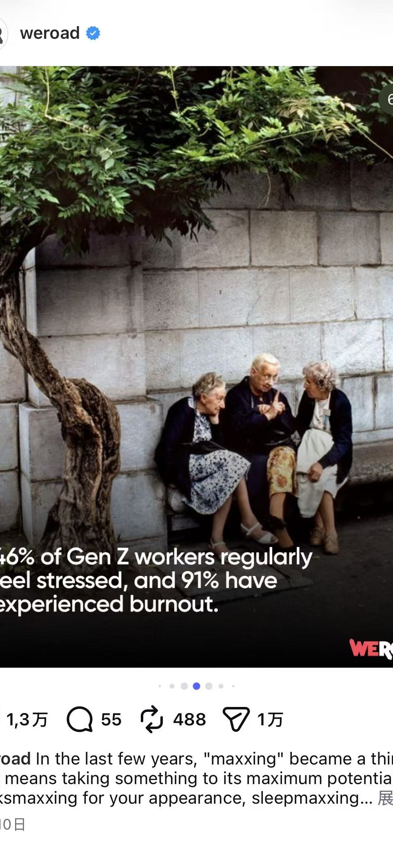
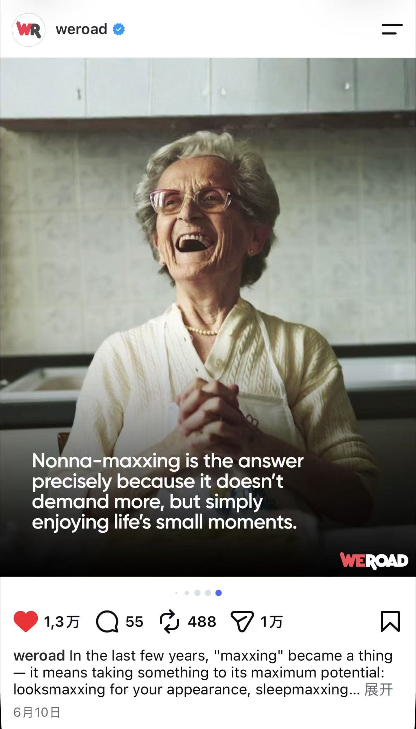
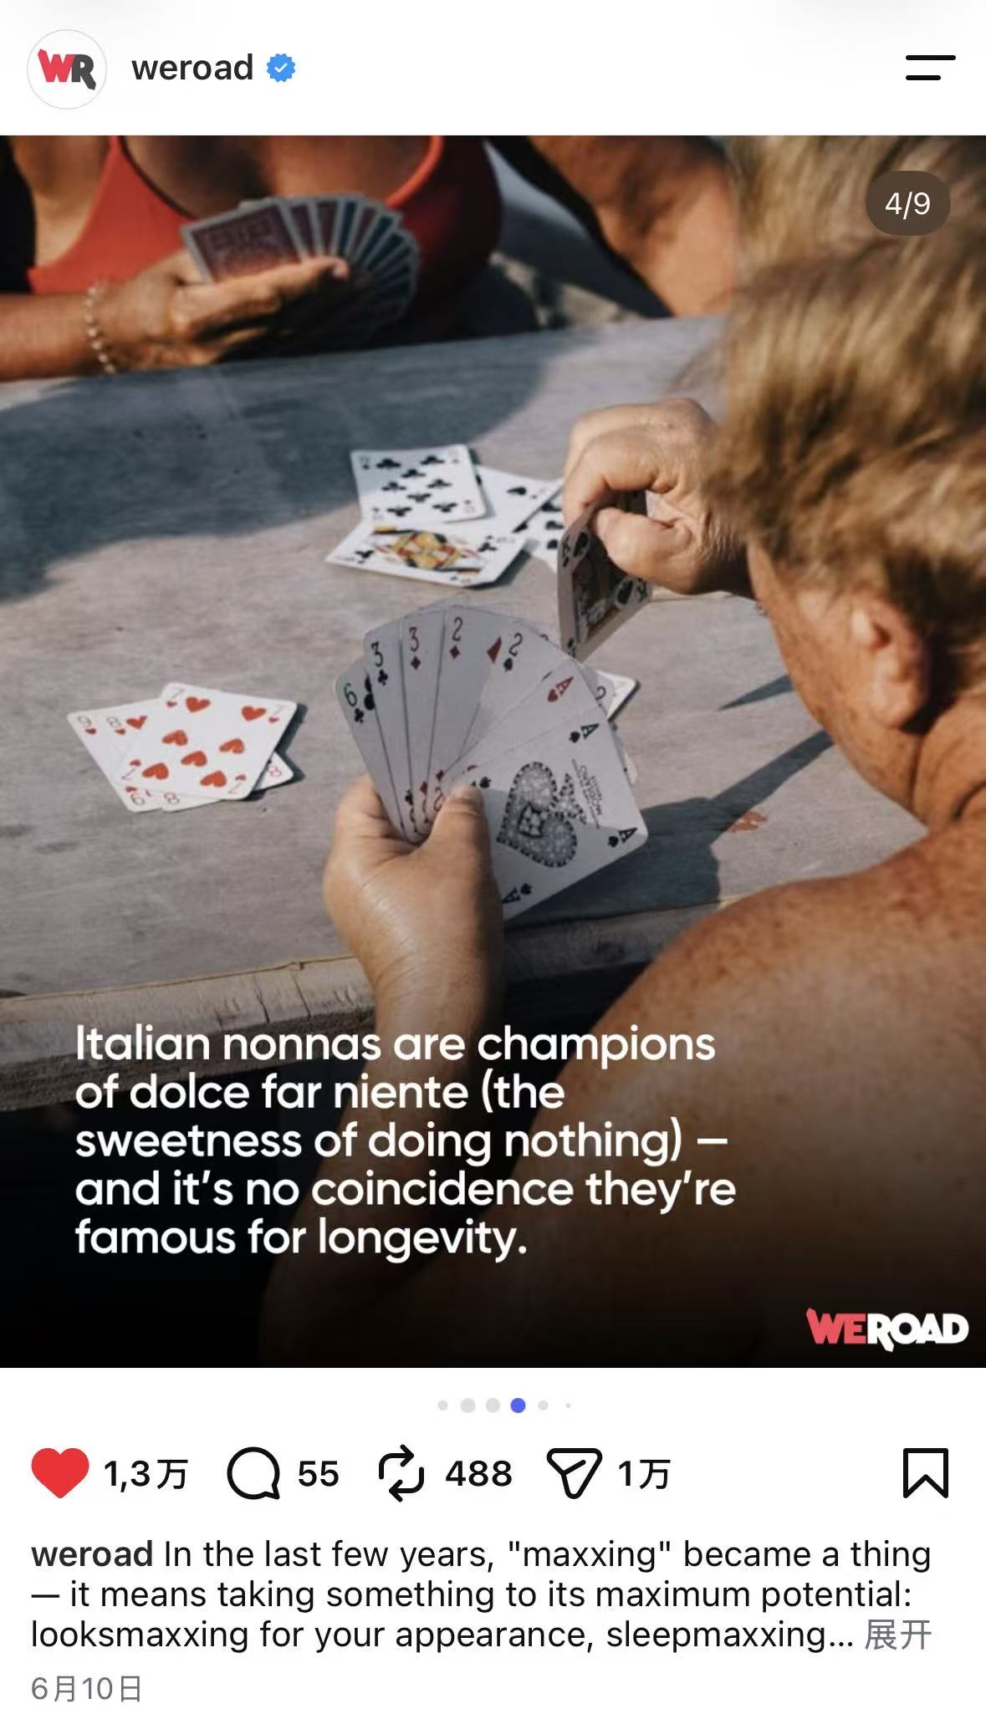
CONTENT CASE / THE ORIGIN
04
THE IDEA STARTED IN CLASS—
THEN CLICKED ON THE STREET.
An Organizational Psychology discussion made one pattern stick: prolonged pressure and heavy workload can begin by disrupting sleep, then spill into health and daily life. In Milan, the nonne I met seemed to protect their energy through routine, relationships and unhurried time.
DOLCE FAR NIENTE.
COURSE INSIGHT → DAILY OBSERVATION →
A CULTURAL FORMAT PEOPLE ALREADY UNDERSTOOD

Slide 5
CONTENT CASE / NONNA-MAXXING
05
A LIGHT FORMAT CARRIED
A REAL TENSION.
Humour, familiar nonna rituals and “dolce far niente” made burnout easier to discuss. The idea also matched WeRoad’s promise: travel, people and new experiences can create space to reset.
STRONG SOCIAL IDEAS CAN START WITH KNOWLEDGE + OBSERVATION—NOT ONLY TREND-CHASING.
13K likes · 55 comments
488 reposts in the captured post

Slide 6
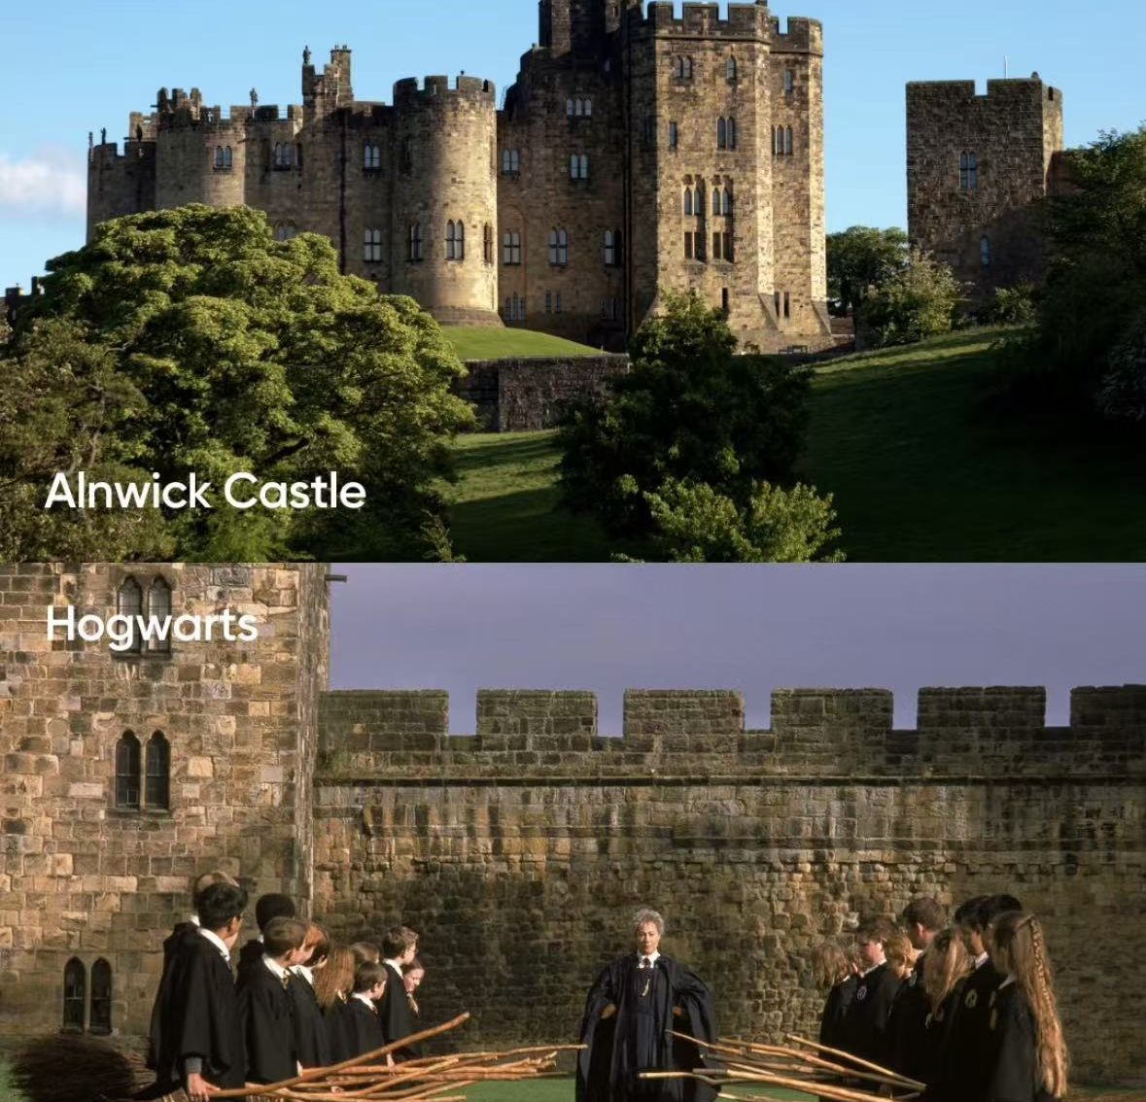
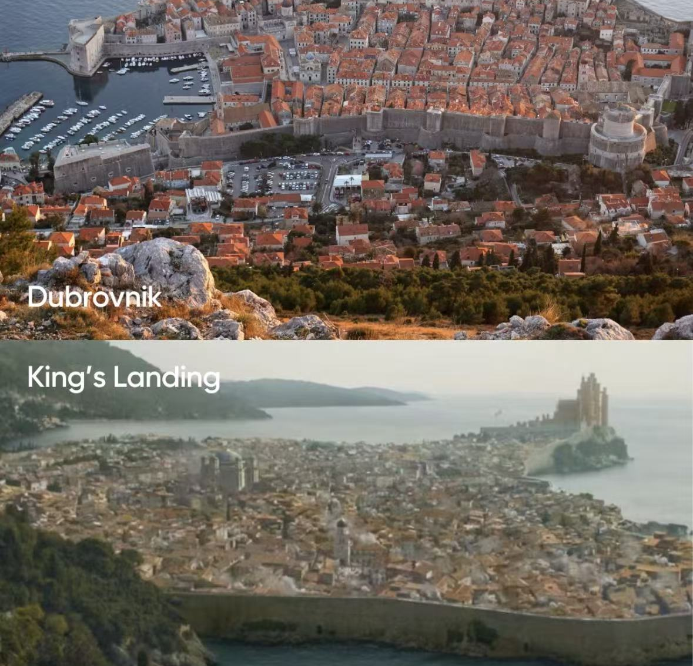
CONTENT CASE / CINEMA → DESTINATION
06
REAL PLACES BORROWED THE MEMORY
OF FAMOUS SCENES.
Each carousel paired a destination with the film or series that made it recognizable—turning entertainment familiarity into travel desire.
ALNWICK CASTLE / HOGWARTS
MAYA BAY / THE BEACH
DUBROVNIK / KING'S LANDING

Slide 7
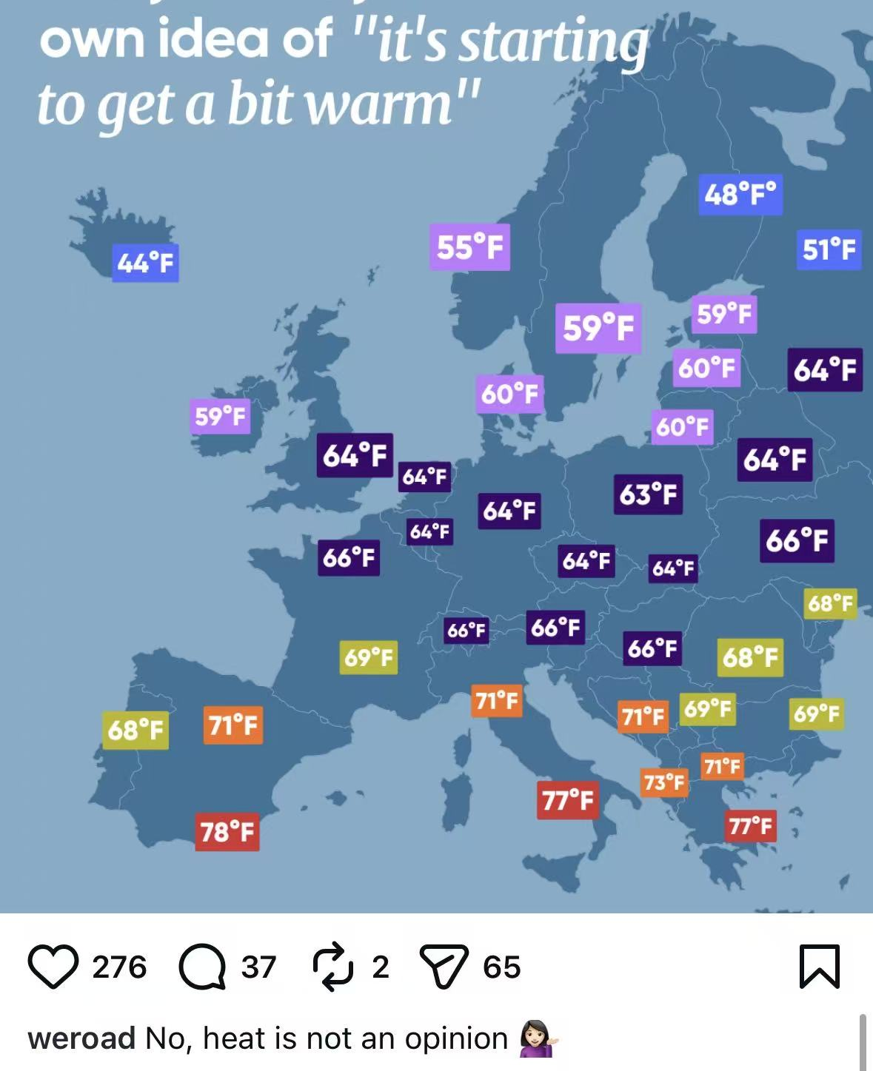
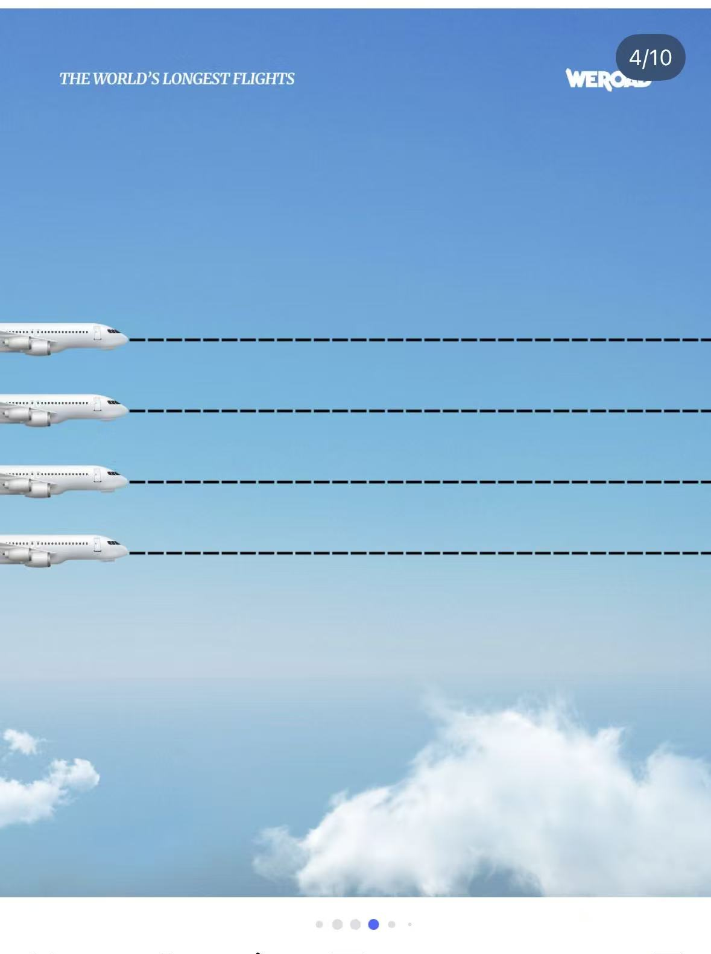
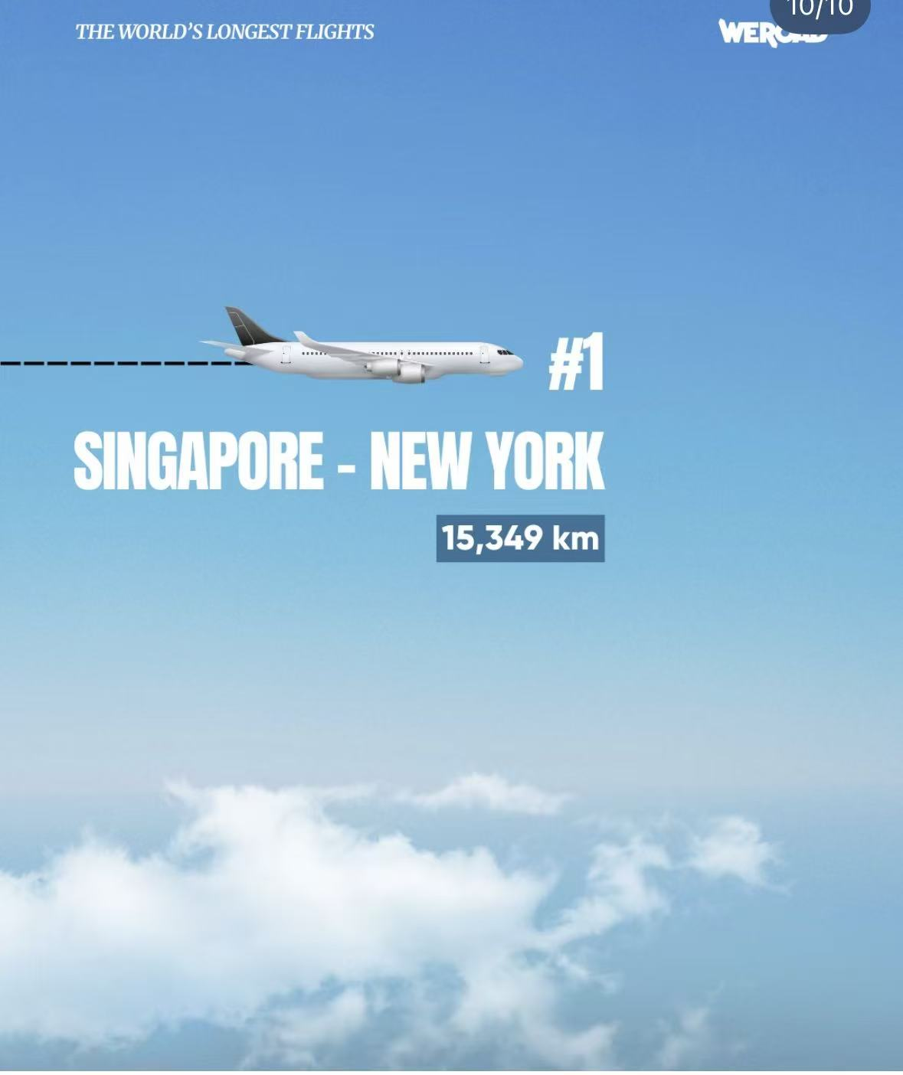
CONTENT CASE / CULTURAL CURIOSITY
07
TRAVEL FACTS BECAME
VISUAL CURIOSITY.
Maps made invisible cultural differences visible; the flight ranking used motion and suspense to keep users swiping.
CULTURE MAPS
MOTION AS A SWIPE MECHANIC
→
→

Slide 8
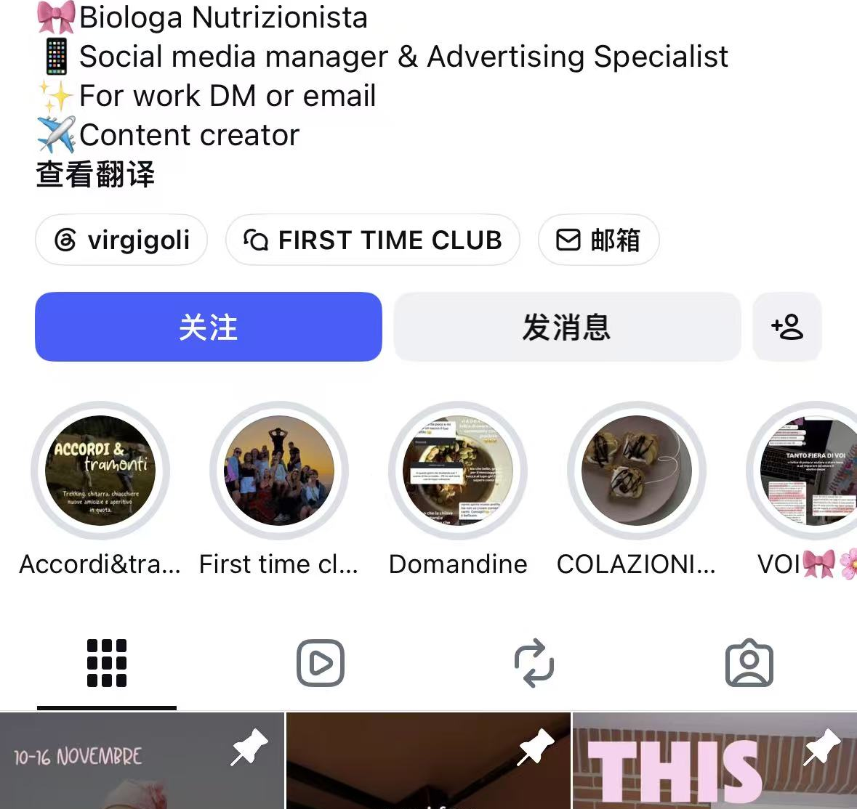
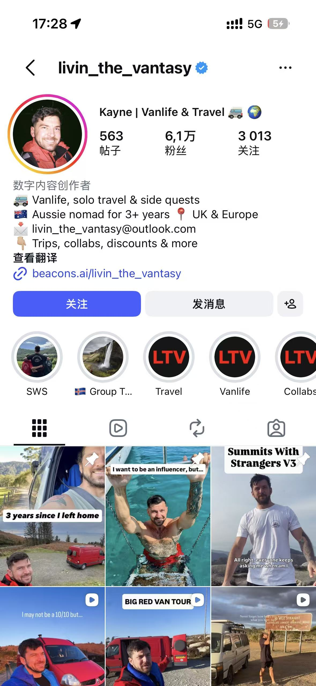
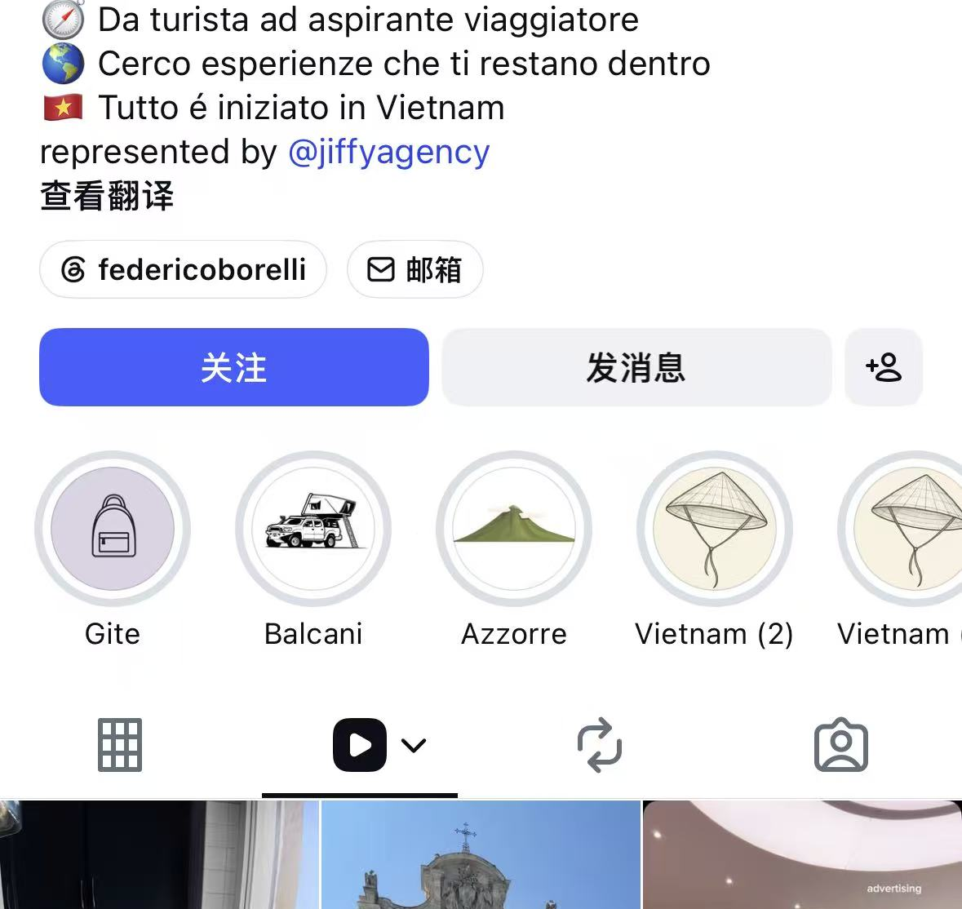
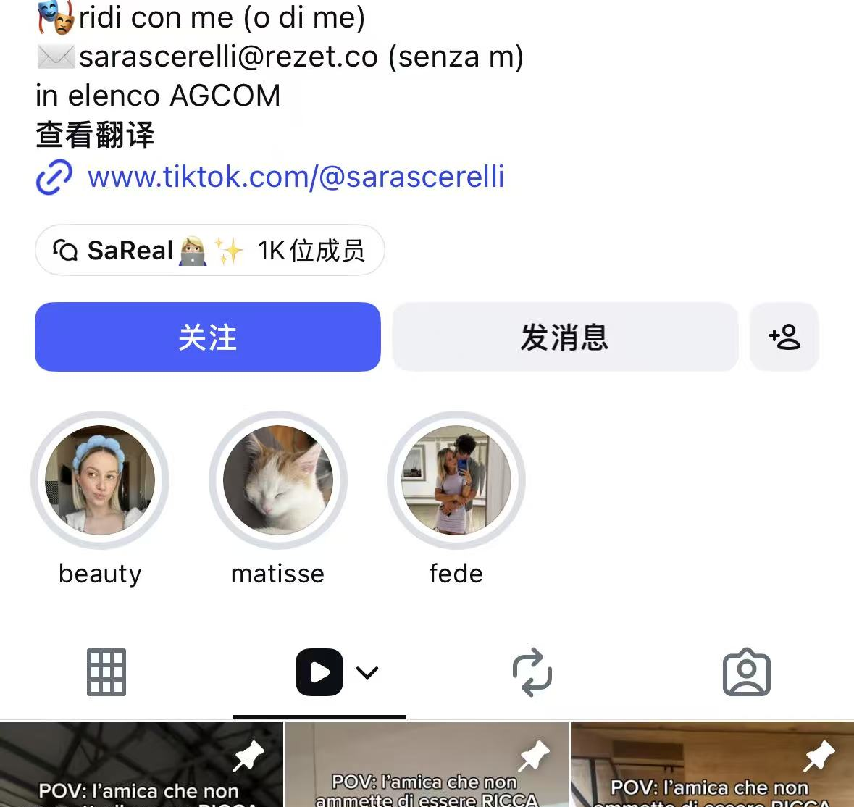
CREATOR PORTFOLIO
08
THE MIX BALANCED
REACH, TRUST AND CONVERSION.
Micro, mid-tier and macro creators were matched to different campaign jobs—not treated as one interchangeable list.
VIRGIGOLI
LIVIN_THE_VANTASY
FEDERICOBORELLI
SARASCERELLI
12K
61K
83K
269K
MICRO · LIFESTYLE / TRAVEL
MID-TIER · VANLIFE / OUTDOORS
MID-TIER · ADVENTURE TRAVEL
MACRO · LIFESTYLE / COMEDY

Slide 9
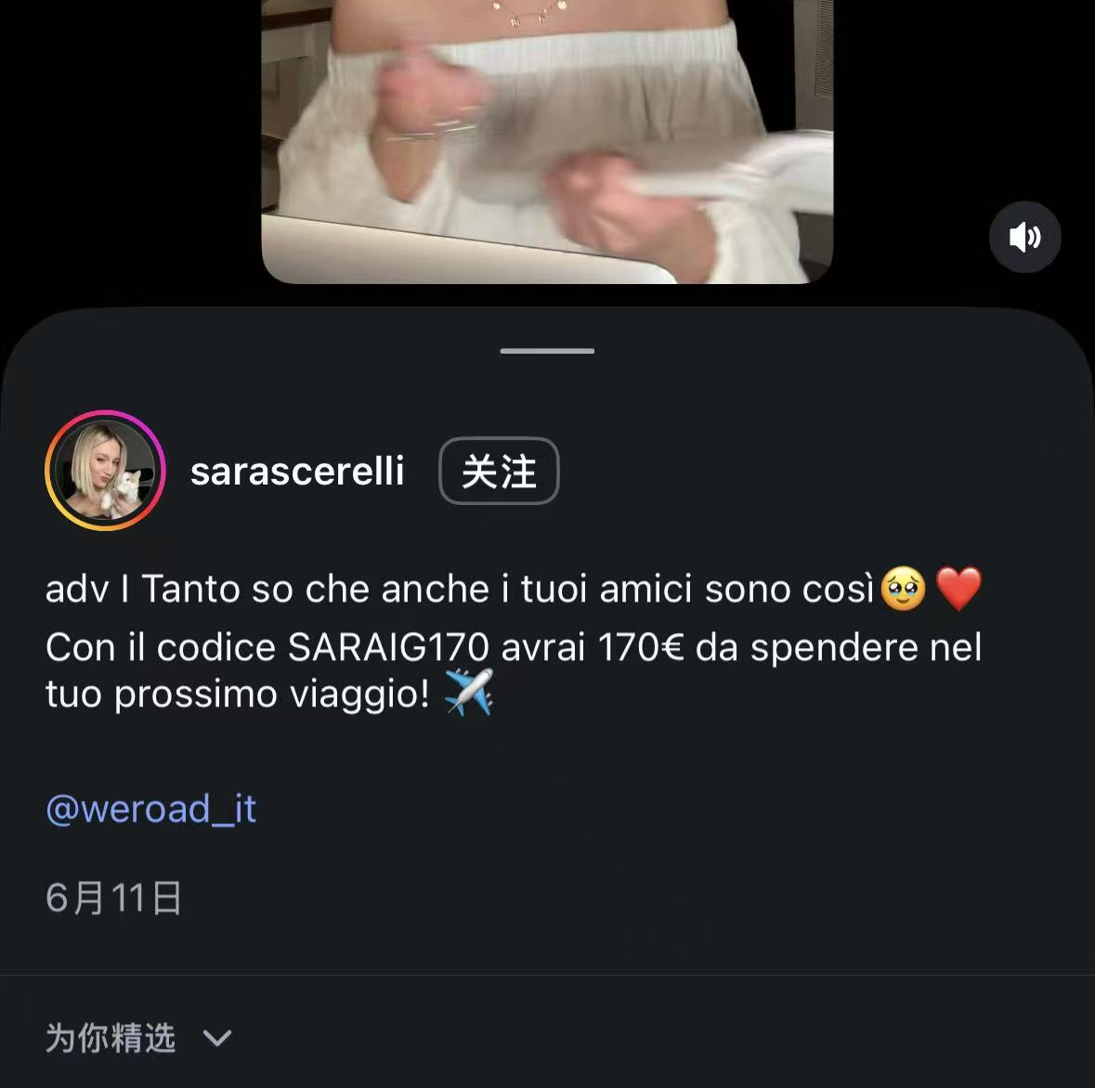
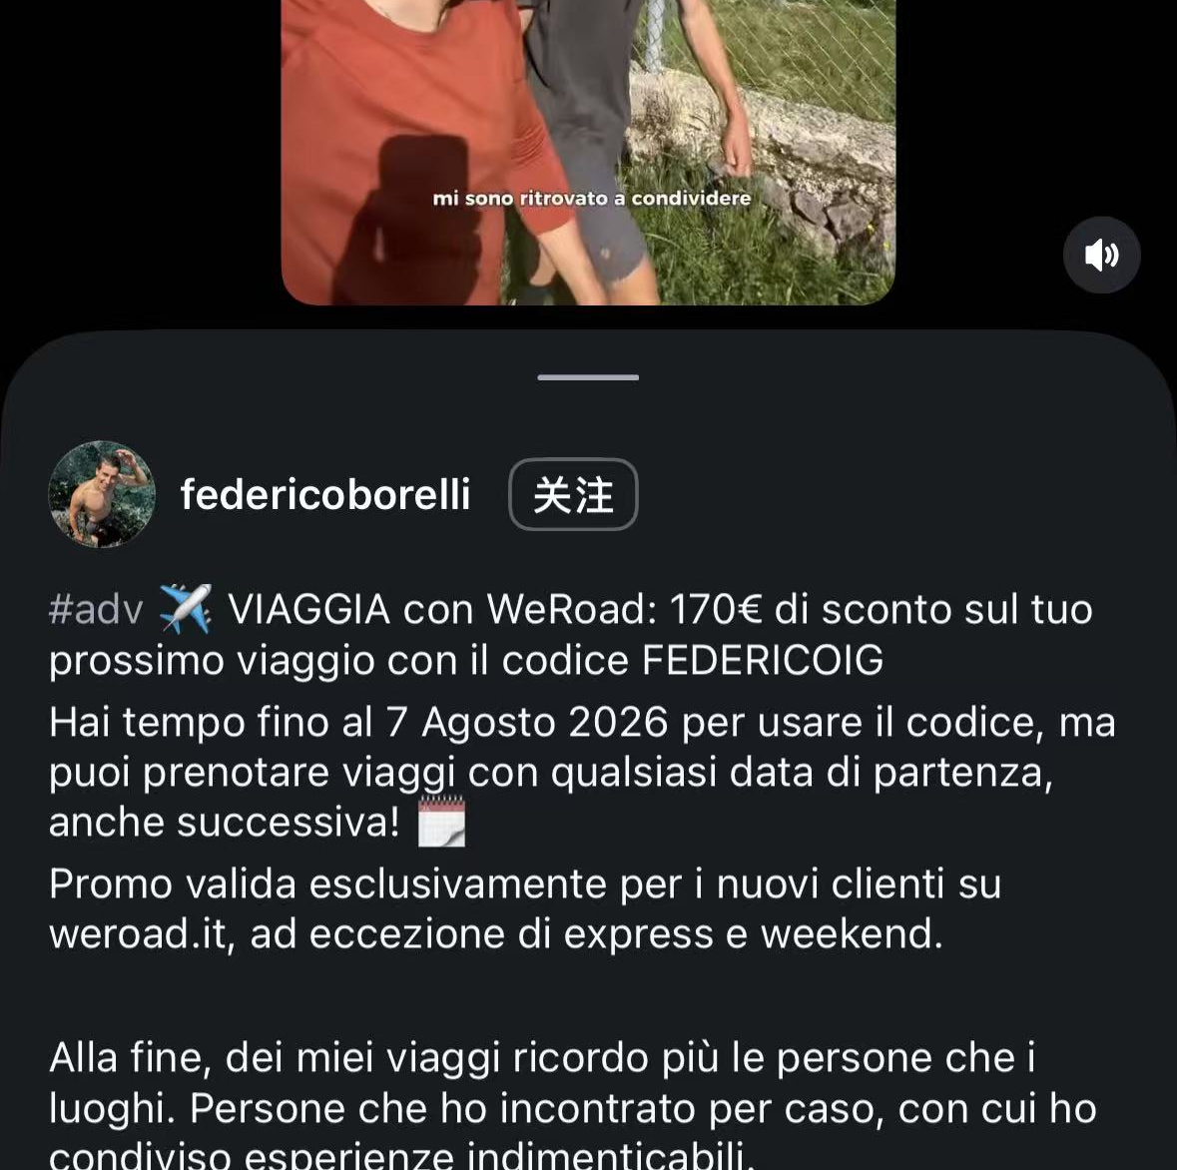
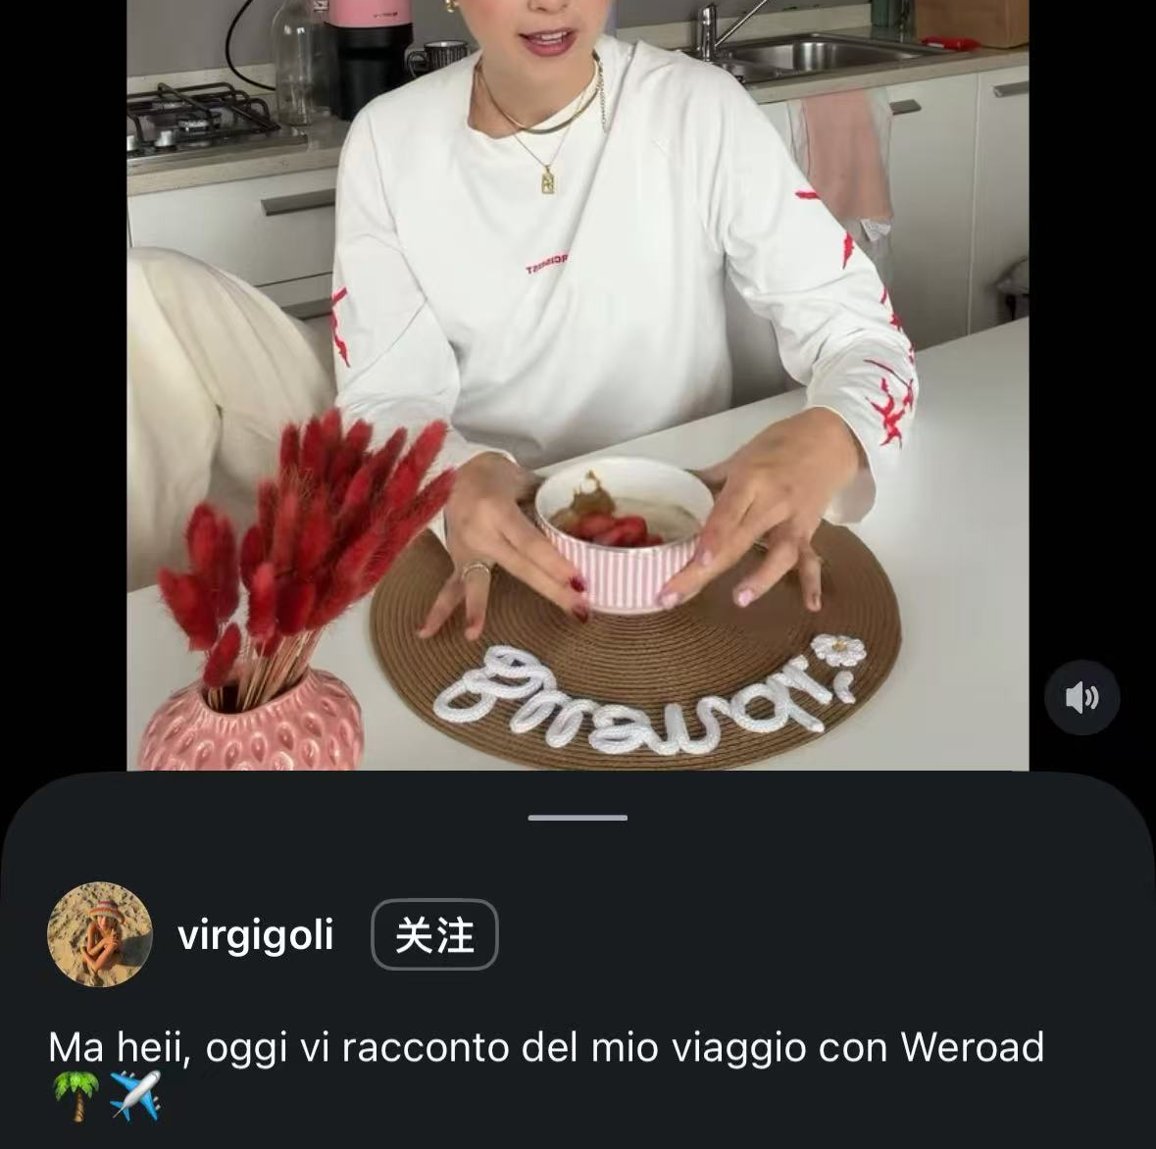
PARTNERSHIP FORMATS
09
THE FORMAT CHANGED
WITH THE OBJECTIVE.
PROMOTION
STORYTELLING
AUTHENTICITY
Macro reach + coded offer
Personal narrative + offer
First-person trip reflection

Slide 10
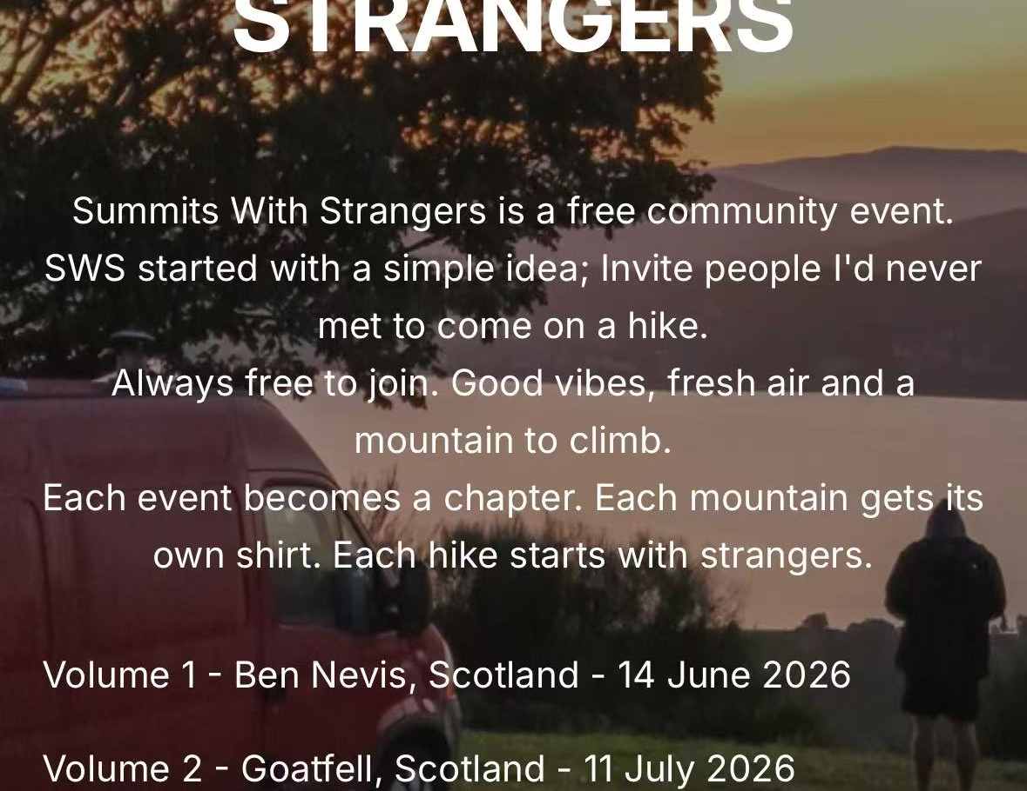
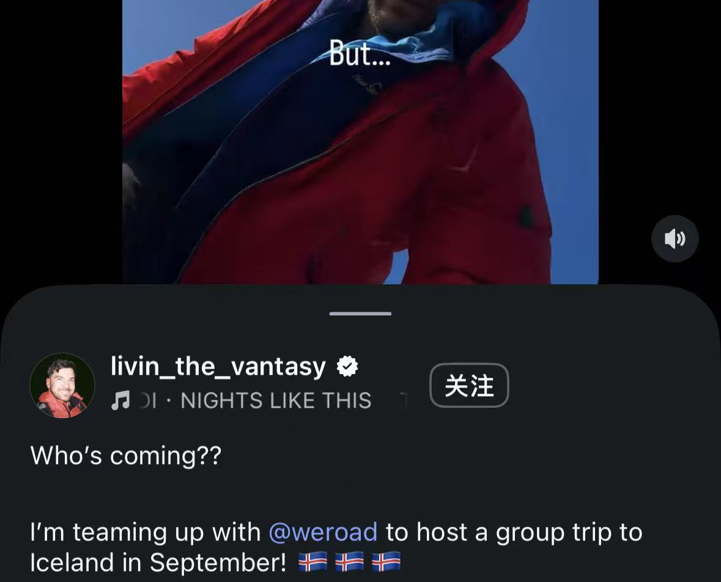
CREATOR → GROUP LEADER FIT
10
GROUP LEADER FIT WAS VISIBLE
BEFORE THE BRIEF.
He already brought strangers together outdoors. That combination—content, coordination and group energy—matched WeRoad’s product more closely than reach alone.
SUMMITS WITH STRANGERS
→
→
OUTDOOR CREDIBILITY
STRANGERS SHOWED UP
GROUP LEADER POTENTIAL
REACH INTRODUCES. COMMUNITY SKILL BUILDS THE TRIP.

Slide 11
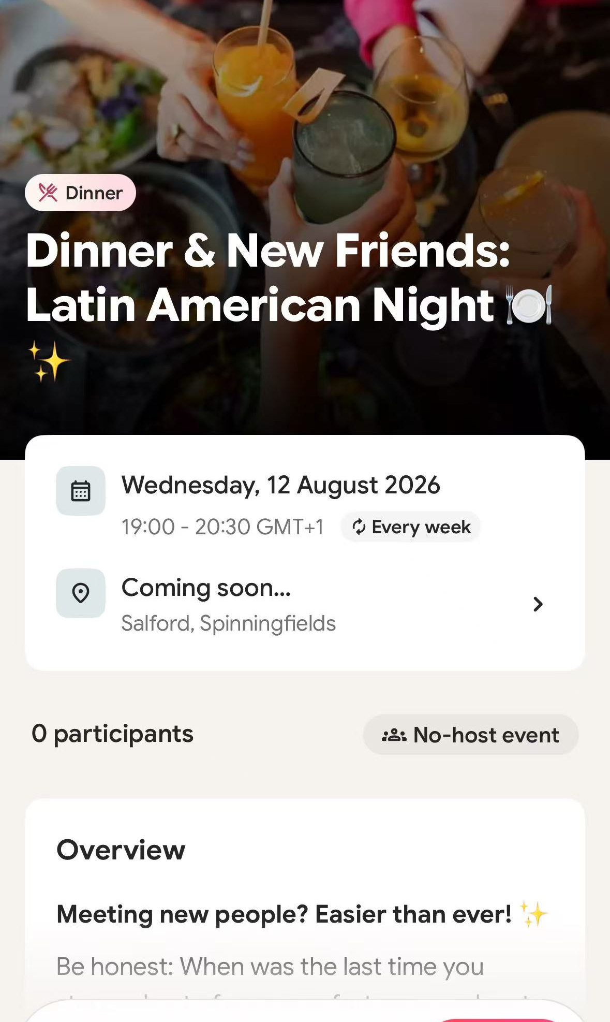
COMMUNITY EVENT / THE PROMISE
11
THE EVENT STARTED
WITH A SIMPLE
PROMISE.
“MEETING NEW PEOPLE?
EASIER THAN EVER.”
A small table, a reserved venue and an in-app chat turned an abstract community idea into a clear reason to show up.
THE INVITATION
A clear social promise, designed to become a real shared table.
ONE OF 4+ COMMUNITY EVENTS
TURN THE PAGE →

Slide 12
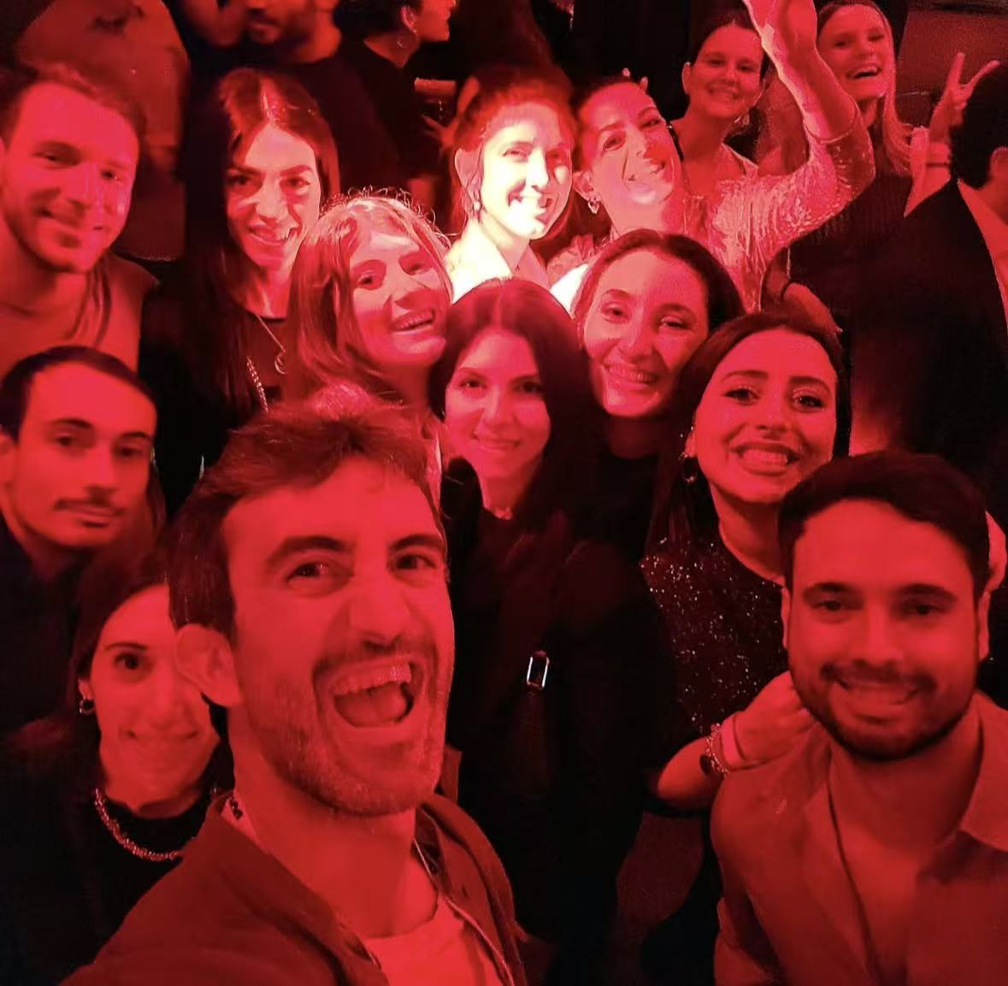
COMMUNITY EVENT / THE REVEAL
12
THE PROMISE
BECAME A ROOM
FULL OF NEW
CONNECTIONS.
The listing lowered the social barrier; the shared table delivered the promise the brand made—new people meeting in real life.
LISTING → LIVED EXPERIENCE

Slide 13
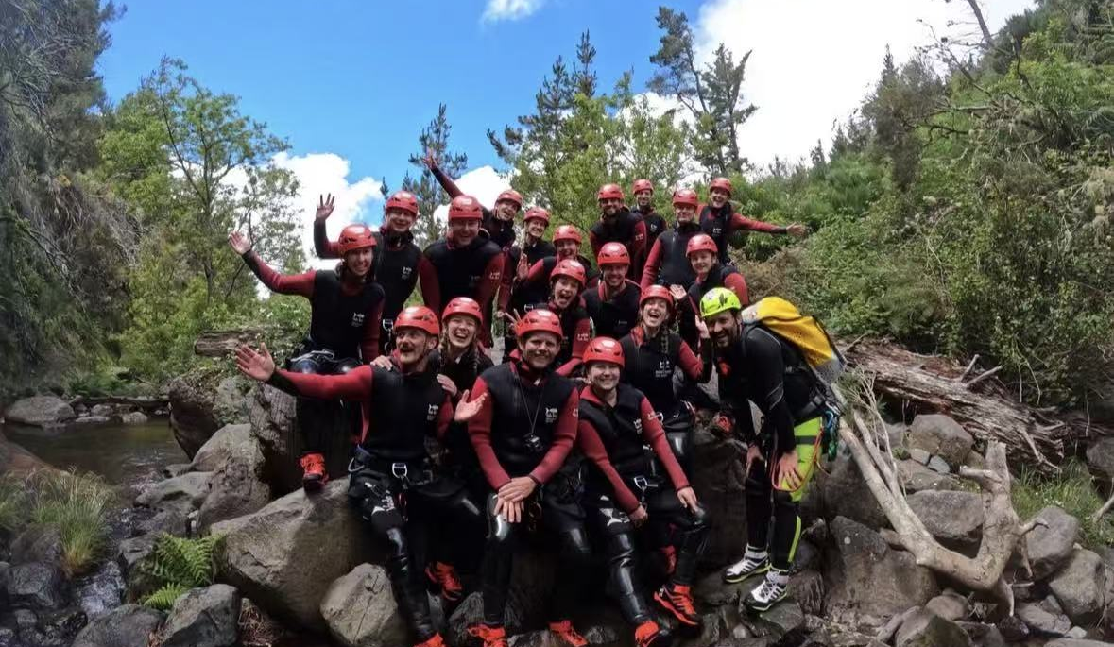
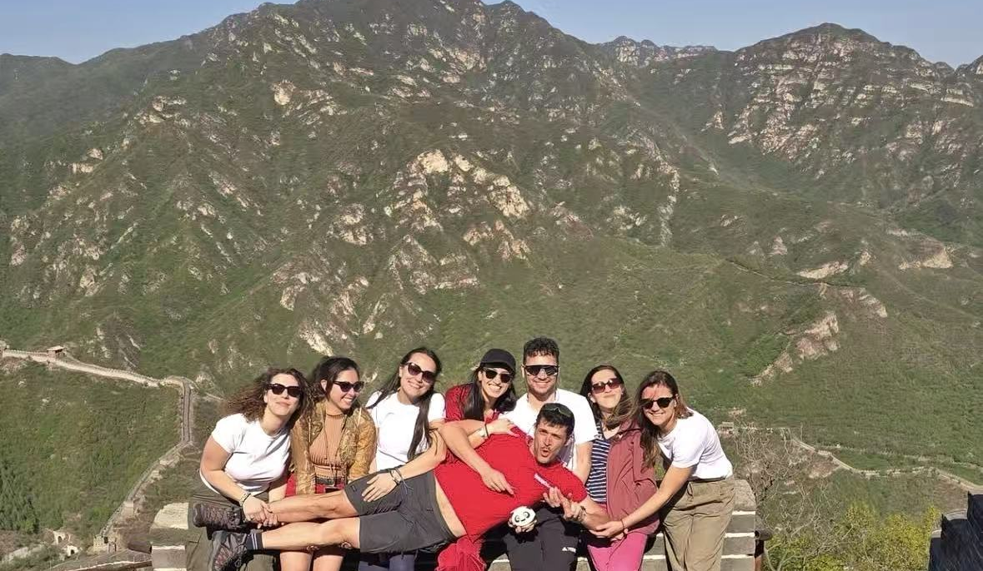
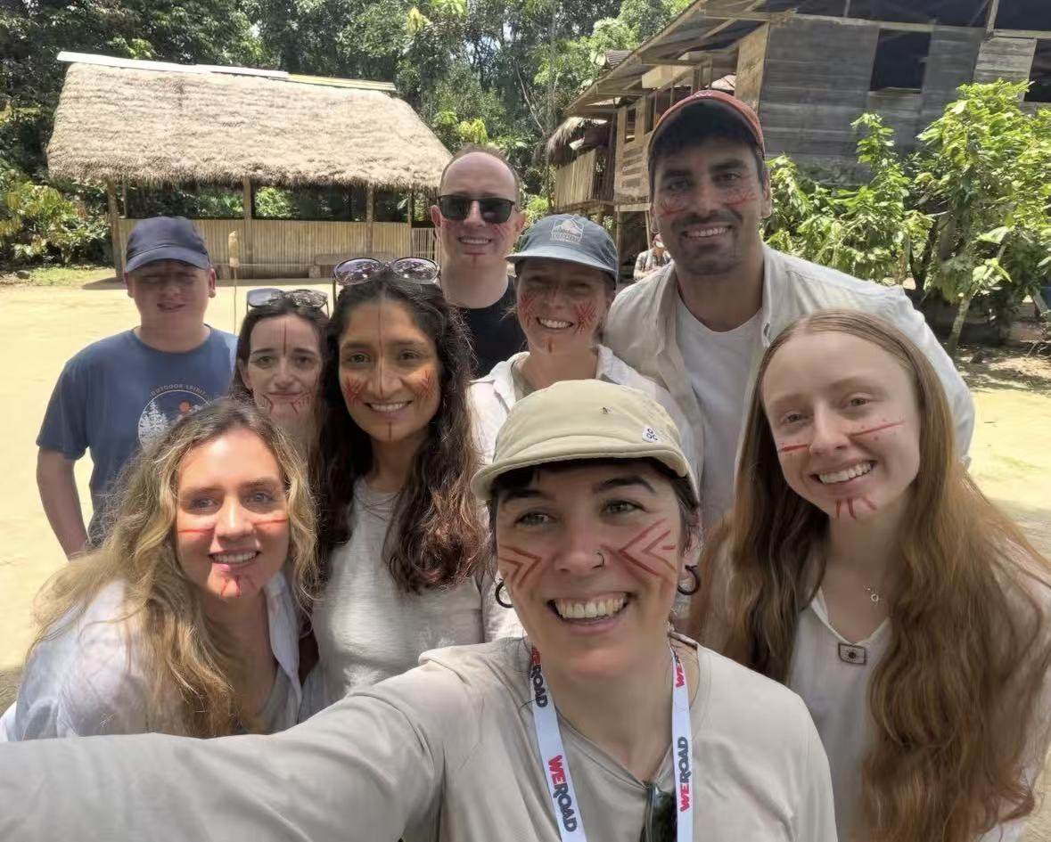
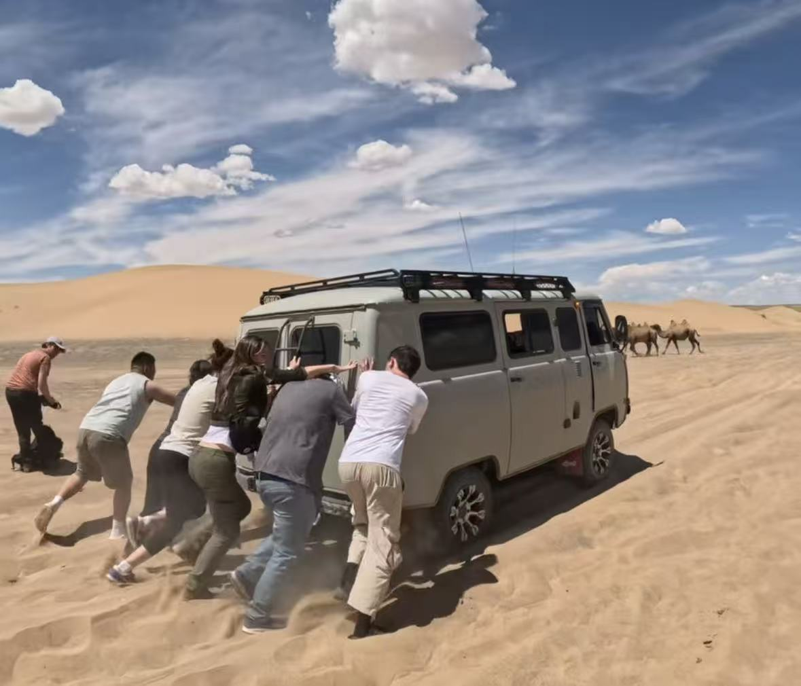
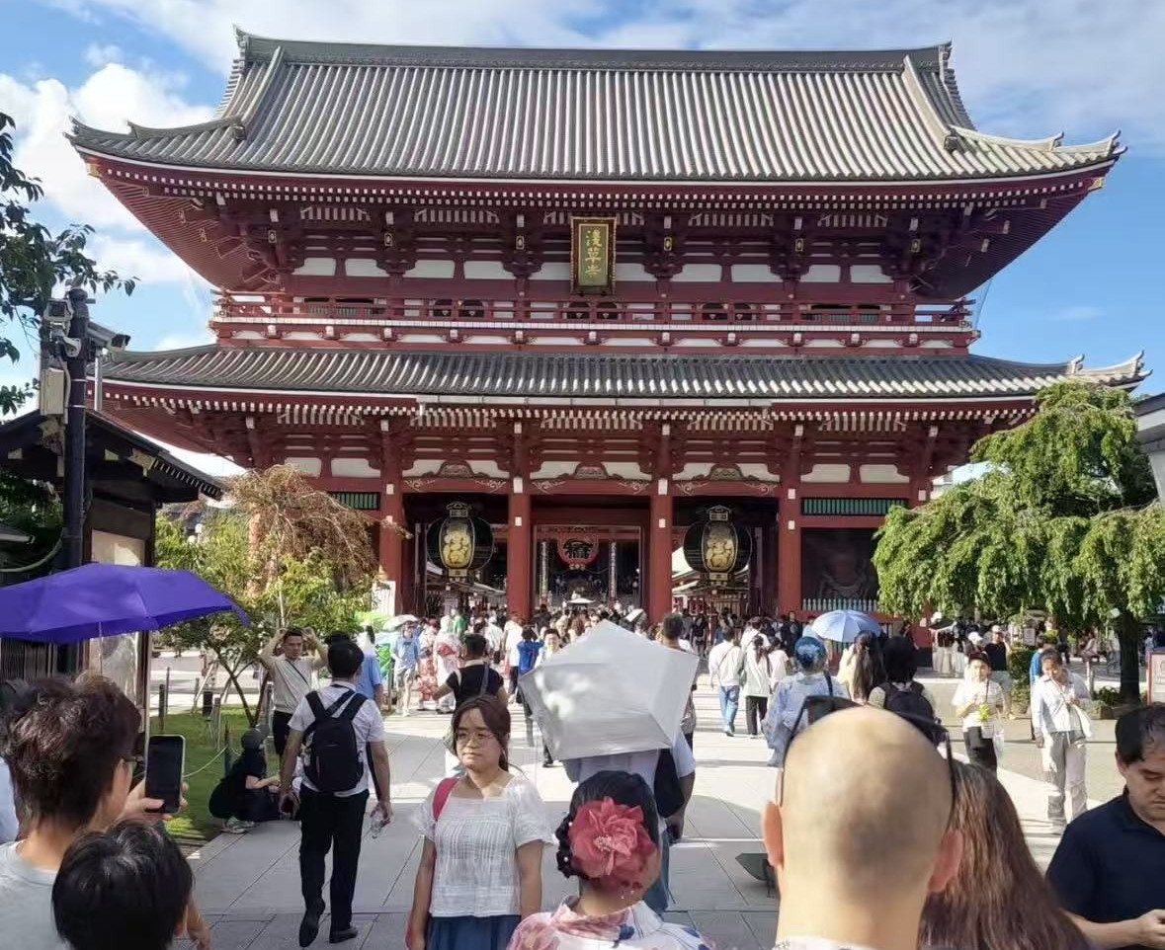
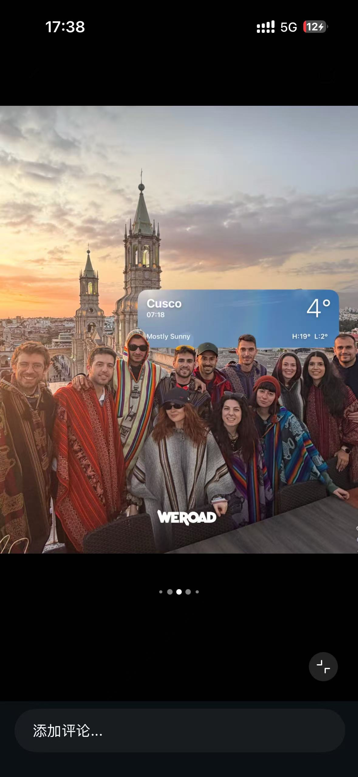
UGC LIBRARY
EVERY TRIP
CREATED PROOF
THE BRAND
COULD REUSE.
Images and videos were organized and tagged as a reusable asset library for future organic and paid content.

Slide 14
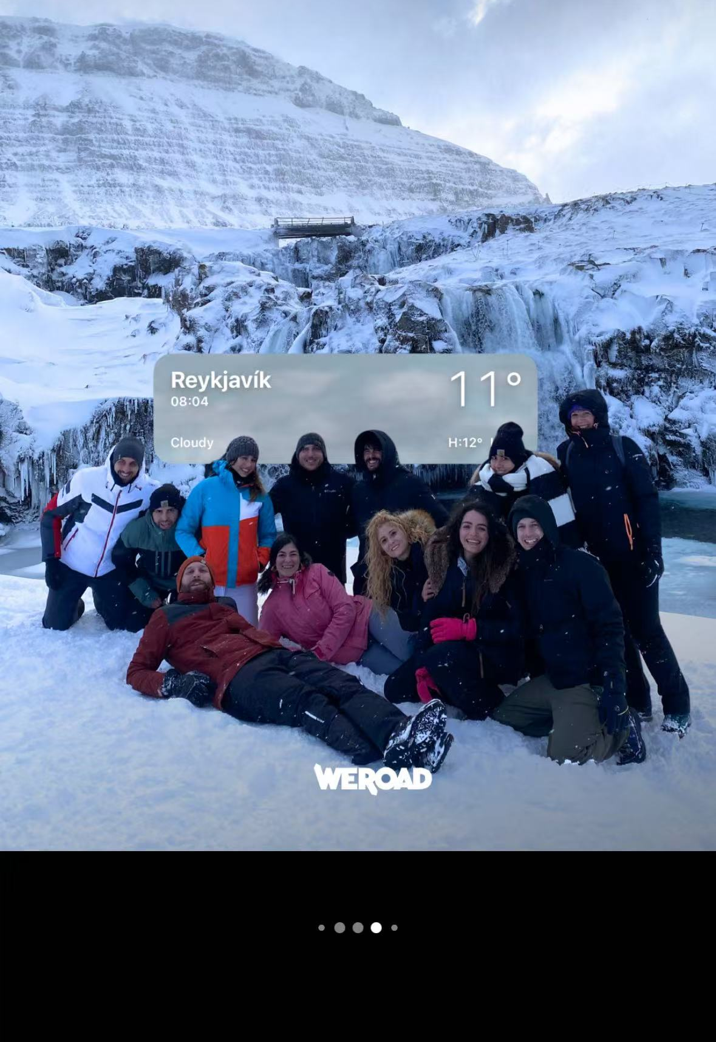
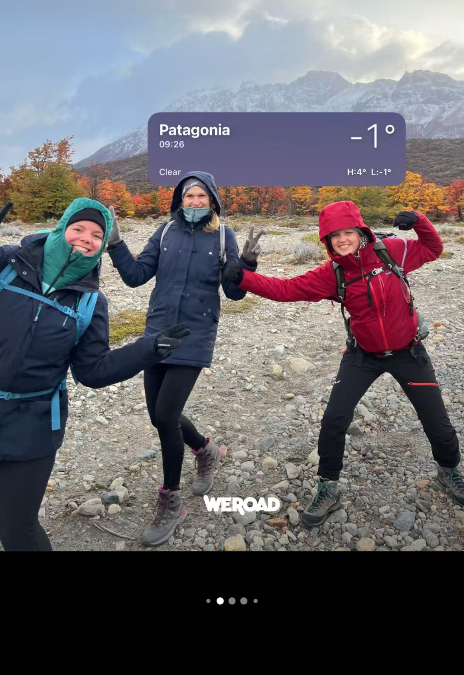
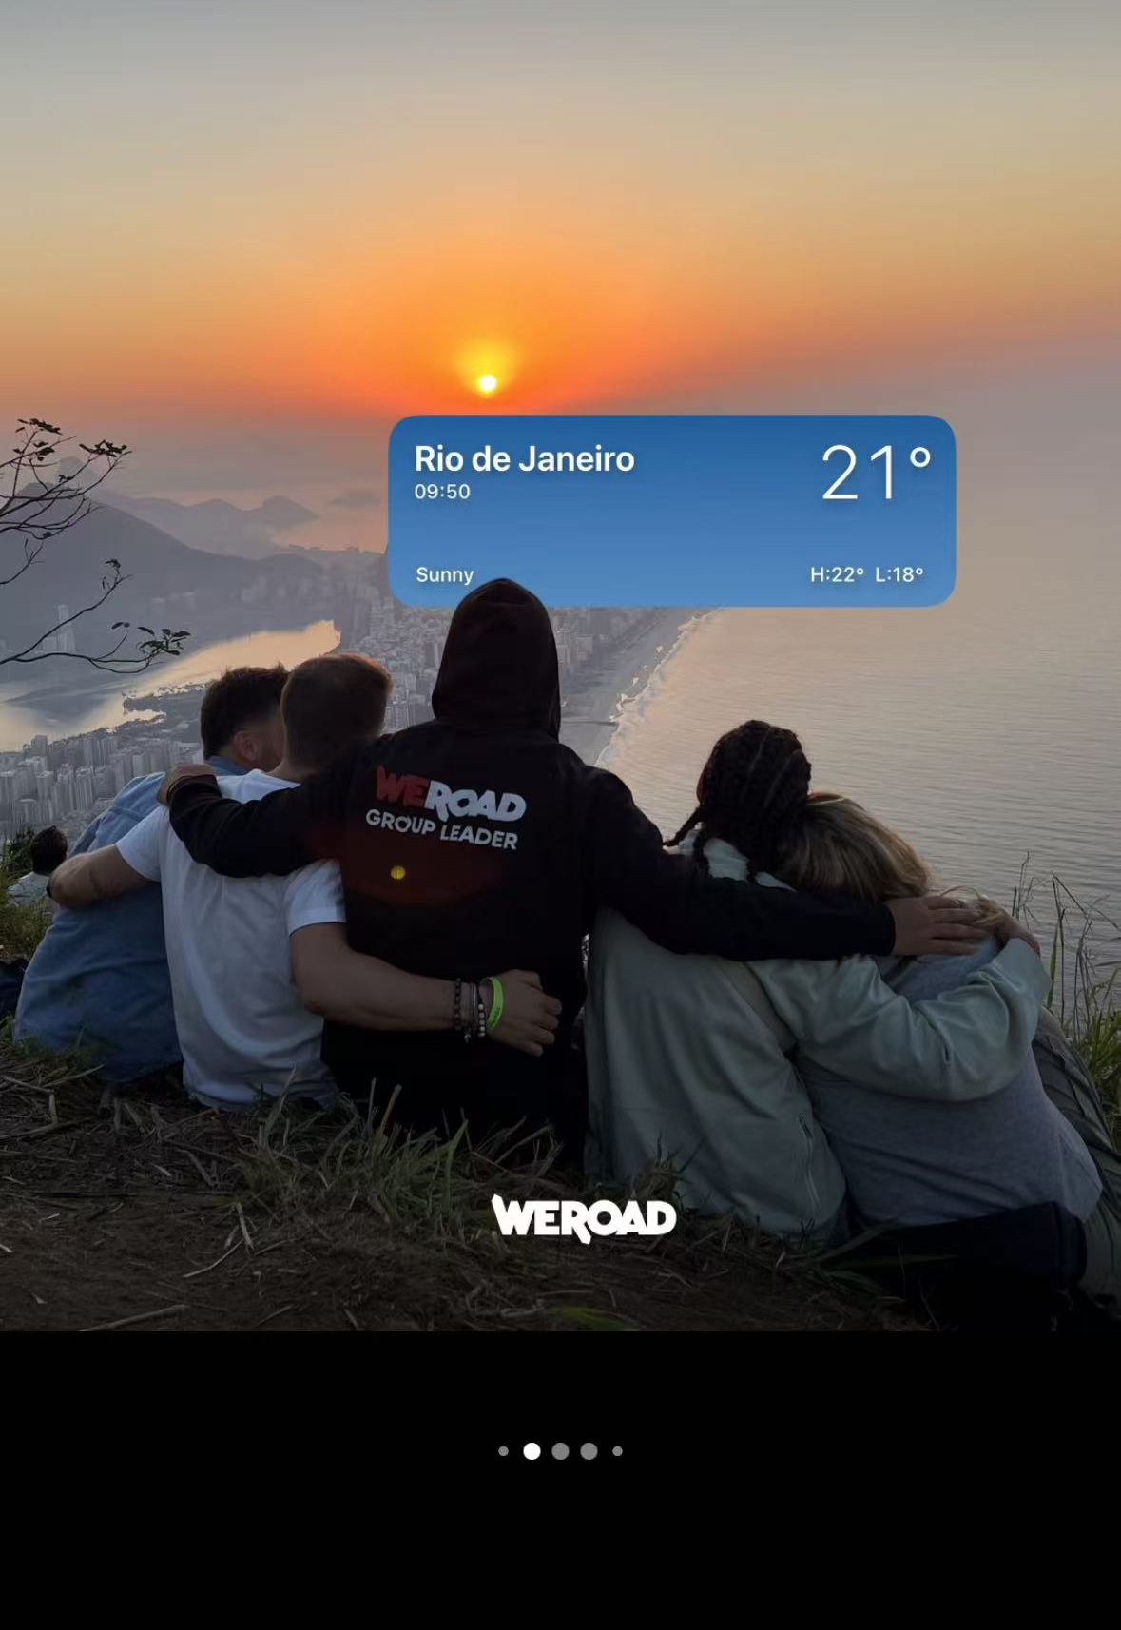
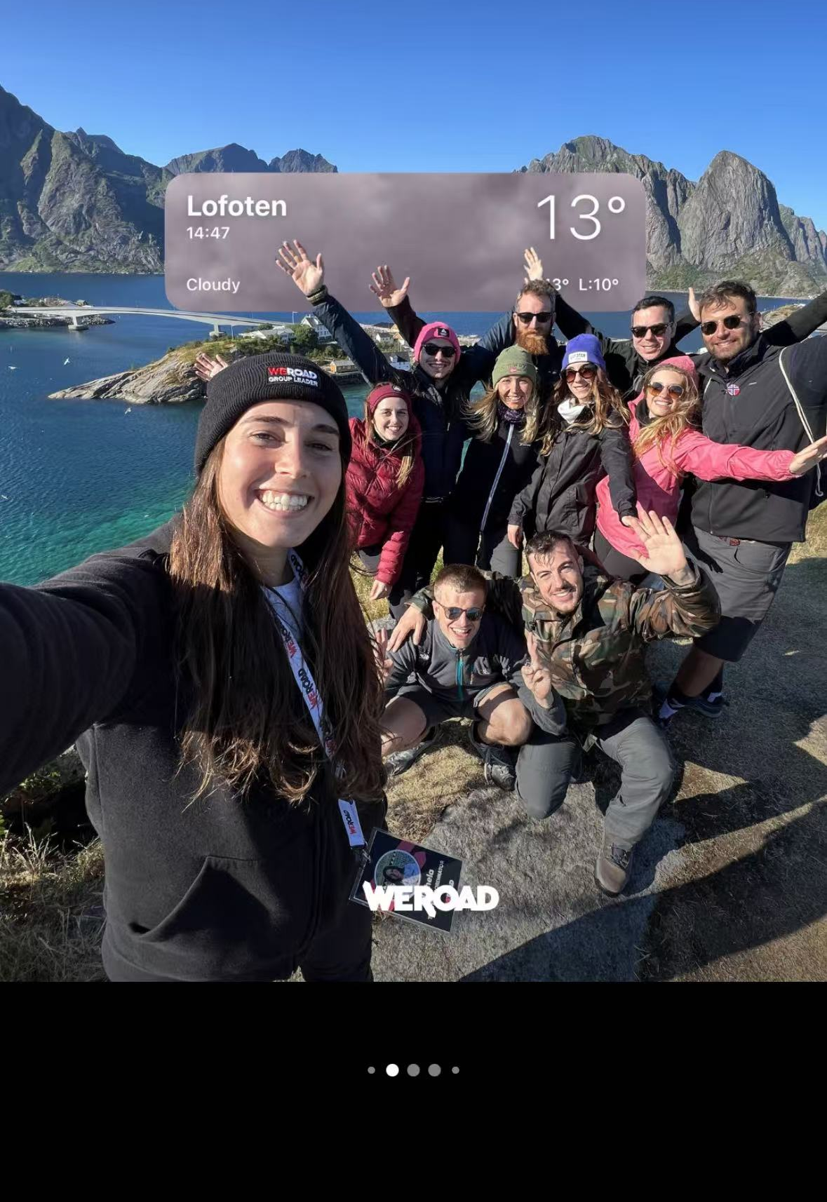
UGC LIBRARY / DESTINATION SERIES
14
ONE VISUAL DEVICE MADE
SCATTERED MEMORIES FEEL LIKE ONE BRAND.
A consistent weather-card motif transformed dispersed trip moments into a recognizable destination series—while keeping the people and places at the center.
CUSCO
REYKJAVÍK
PATAGONIA
RIO
LOFOTEN

Slide 15
200–300
I WORKED ACROSS THE
OPERATING LAYER BEHIND
SOCIAL TRAVEL GROWTH.
creators sourced in total
60+
collaborations supported
The work connected what audiences see with who carries the message, where community forms and how each trip keeps producing usable brand proof.
4+
community events
UGC
DU FANG
library maintenance & organization
OVERSEAS MARKETING · MILAN

